Slide 1
OFFICE OF RESEARCH SERVICES – OVERVIEW
April 3, 2024

Slide 2
Agenda
Introduction to the Office of Research Services
Brief walkthrough of Kuali Research

Slide 3
Resources
Office of Research Services Website: https://www.lsuhsc.edu/administration/academic/ors/
Training Requirements: https://www.lsuhsc.edu/administration/academic/ors/irb/educational_requirements.aspx
IF YOU HAVE QUESTIONS – CONTACT US!!!

Slide 4
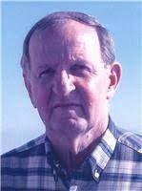
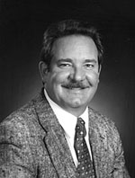
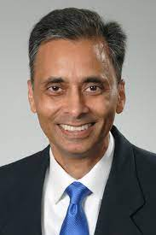
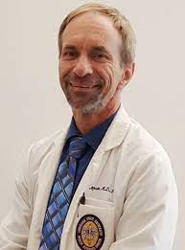
ORS - Business Plan – Background
Vital Segment of LSUHSC for over 35 years
M. Wayne Hurst, PhD: 1985 – 2000
- facilitated Dr. Hagensee getting 1st grant!
Kenneth Kratz, PhD: 2000-2017
- named Dr. Hagensee as an IRB member!
Jawed Alam, PhD: 2017 – 2023
- convinced Dr. Hagensee to replace him!
Michael Hagensee, MD, PhD: 2023 - ??
Notes:
read me-lots of sera screened
MAINLY WORK OF JODY AND GREG
-can’t go over all data
-ask specific questions IN NL host
spend more time on ADS study

Slide 5
ORS How Much?
Peak in 2004 at 66 million
Nadir in 2018 at 39 million
Nice recent trend but
mostly institutional funds
Notes:
read me-lots of sera screened
MAINLY WORK OF JODY AND GREG
-can’t go over all data
-ask specific questions IN NL host
spend more time on ADS study

Slide 6
Office of Research Services
Office of Research Services
IACUC
IRB
COI
Office of Grants Compliance
Clinical Trials Office
Executive Director:
Dr. Michael Hagensee
IBC

Slide 7
Conflicts of Interest (COI) Committee
Office of Research Services
IACUC
IRB
COI
Office of Grants Compliance
Clinical Trials Office
Responsible for the review, and management of research-related conflicts of interest.
Who can I contact?
COIOffice@lsuhsc.edu
Anissa Patrick
IBC

Slide 8
Institutional Review Board (IRB)
Office of Research Services
IACUC
IRB
COI
Office of Grants Compliance
Clinical Trials Office
Responsible for the oversight and protection of human subject participating in research. Plans for expansion for educational efforts
Who can I contact?
IRBOffice@lsuhsc.edu
Lynn Arnold
Noel Cal
Mark James
IBC

Slide 9
Office of Grants Compliance
Office of Research Services
IACUC
IRB
COI
Office of Grants Compliance
Clinical Trials Office
Responsible for the evaluation and routing for signatures of all grant applications, and follow-up submissions (i.e., JIT, RPPR, Close-out, etc.). Plans for expansion of this office.
Who can I contact?
Ann Clesi, aclesi@lsuhsc.edu
IBC

Slide 10
Institutional Biosafety Committee (IBC)
Office of Research Services
IACUC
IRB
COI
Office of Grants Compliance
Clinical Trials Office
Responsible for the oversight of biosafety issues and recombinant DNA research.
Who can I contact?
IBCOffice@lsuhsc.edu
Taylor Fuselier
Remi Landry
IBC

Slide 11
Institutional Animal Care and Use Committee (IACUC)
Office of Research Services
IACUC
IRB
COI
Office of Grants Compliance
Clinical Trials Office
Responsible for the oversight and welfare of animals used in research.
Who can I contact?
IACUCOffice@lsuhsc.edu
Taylor Fuselier
Remi Landry
IBC

Slide 12
Clinical Trials Office (CTO)
Office of Research Services
IACUC
IRB
COI
Office of Grants Compliance
Clinical Trials Office
Responsible for the review, negotiation, and execution of all research-related contracts (CTAs, NDA/CDAs, MTAs, DUAs, etc.) & budgets. The CTO also offers coordinator resources and standard SOPs. Plans for access to Biostats core and Research Information Services
Who can I contact?
CTO@lsuhsc.edu
Gabriela Bonvillain
Benjamin Davis
IBC

Slide 13
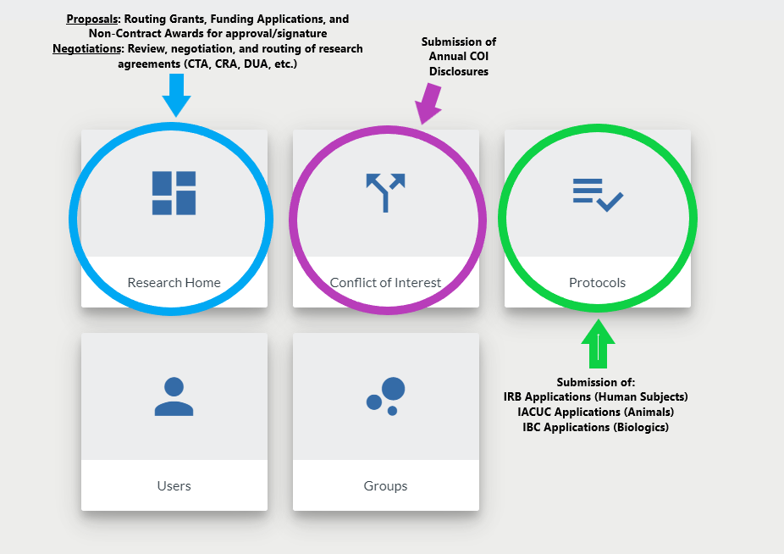
Kuali Research

Slide 14
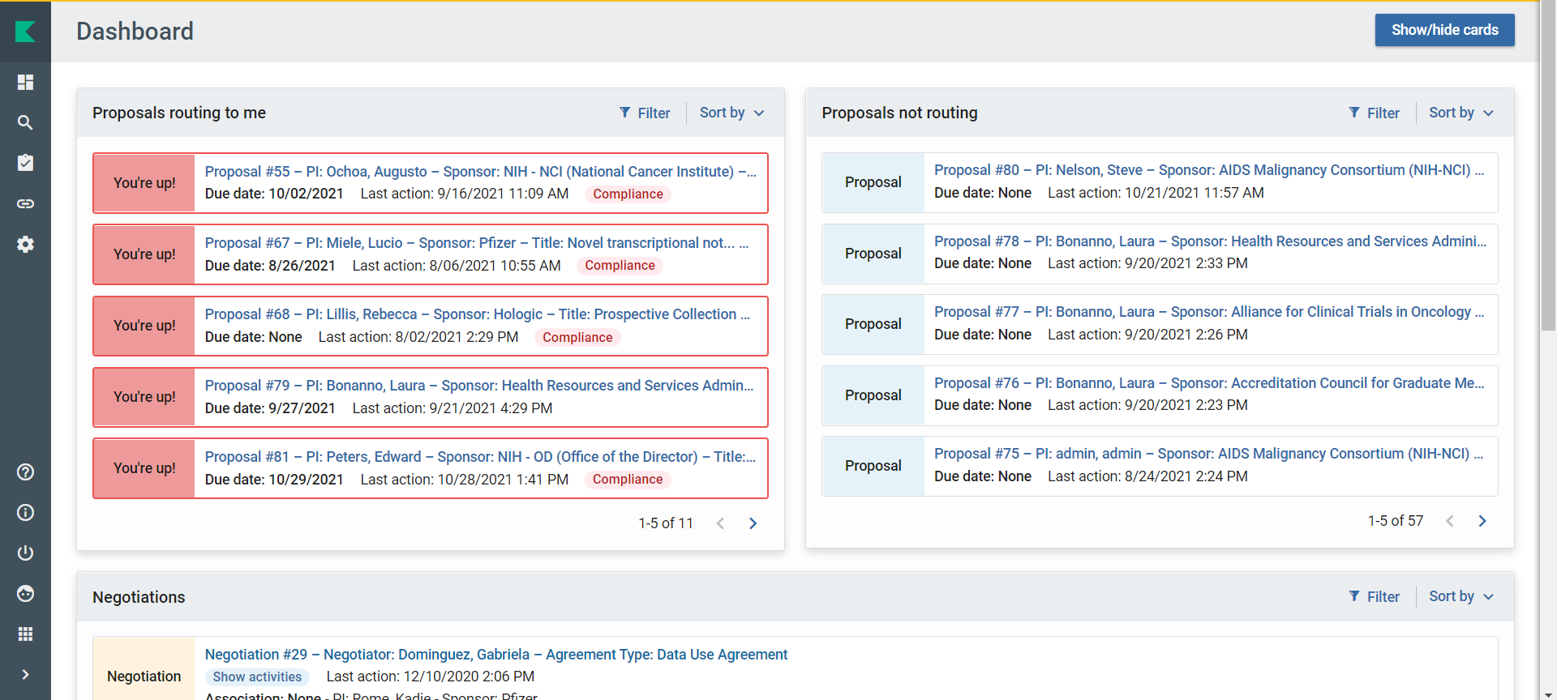
Kuali Research Home – Grants & Contracts

Slide 15
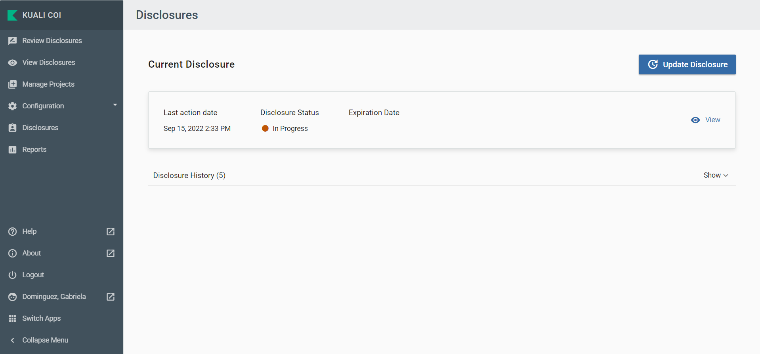
Kuali Conflicts of Interest

Slide 16
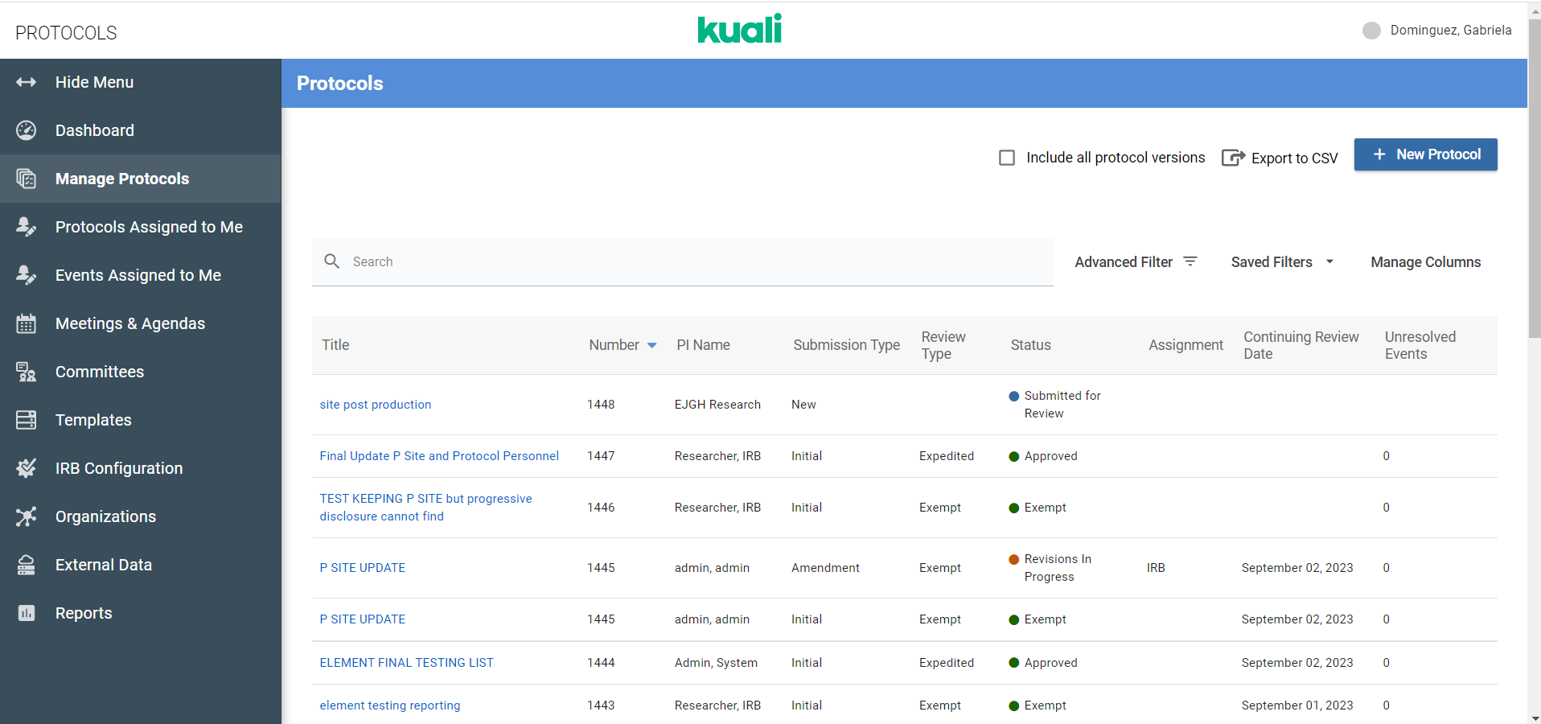
Kuali Protocols – IRB, IBC, and IACUC

Slide 17
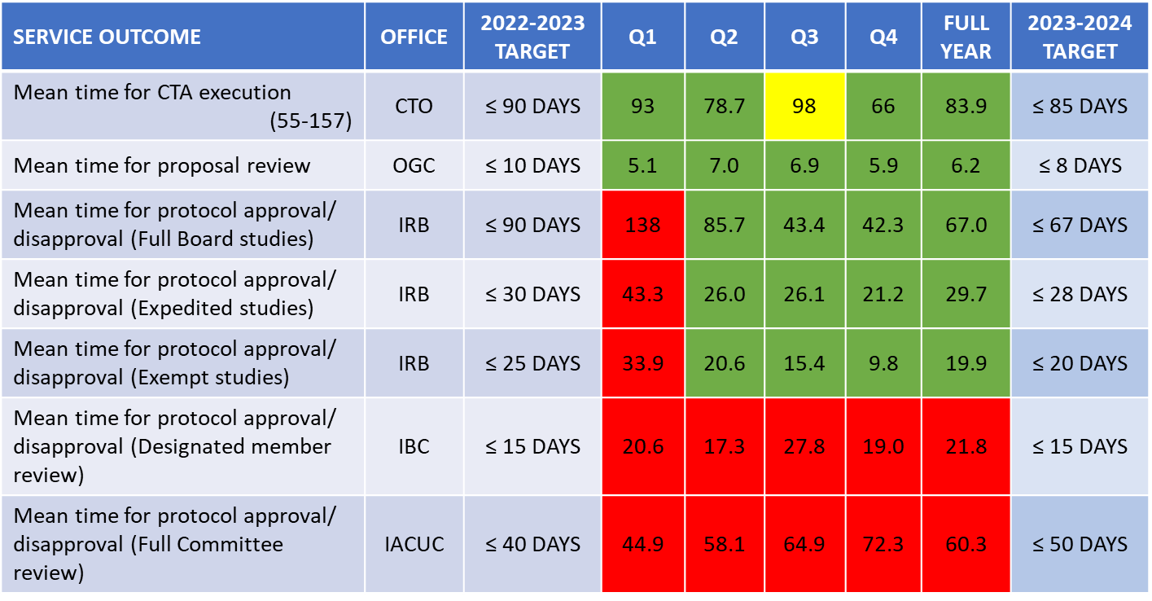
Time Metrics
Excellent! IBC changed workflow, IACUC – better target for 2023-4
Better tracking in the future
Notes:
read me-lots of sera screened
MAINLY WORK OF JODY AND GREG
-can’t go over all data
-ask specific questions IN NL host
spend more time on ADS study

Slide 18
Other Aspects
Education:
Lunch and Learn – expand to all facets of ORS
Develop boot camp curriculum
Attend on-campus research symposia
Attend Departmental Meeting – increase accessibility
Audits:
Assist early on with new studies – get off on the right foot
Notes:
read me-lots of sera screened
MAINLY WORK OF JODY AND GREG
-can’t go over all data
-ask specific questions IN NL host
spend more time on ADS study

Slide 19
Resources
Office of Research Services Website: https://www.lsuhsc.edu/administration/academic/ors/
Training Requirements: https://www.lsuhsc.edu/administration/academic/ors/irb/educational_requirements.aspx
IF YOU HAVE QUESTIONS – CONTACT US!!!

